Slide 1


CONTRACEPTION & STI’s
Year 10 Health Lesson 1 Term 2, 2024

Slide 2
Term 2: Program & Assessments
PROGRAM:
Weeks 1 – 4: Contraception.
Weeks 5 – 11: Sexually Transmitted Infections.
ASSESSMENTS:
Assessment Task 2: Topic Test (week 4)
Contraception
Consent and the law
Options for and impact of unplanned pregnancy
Health Attributes.
Assessment Task 3: STI Presentation (weeks 9 – 11)
Contributes to semester 2 reports.
TERM 1 content
Notes:
Discuss this slide and the upcoming assessment tasks.

Slide 3

Today’s Focus
Review consent.
Introduction to contraception.

Slide 4
ACTIVITY 1: CONSENT REVIEW – BRAINSTORM (pg. 8)
Brainstorm everything you can recall on CONSENT:
What is it?
Examples of how to ask for consent.
How can consent be given?
When can consent NOT be given?
Consent and the law.
You have 5 minutes.
CONSENT
Notes:
Relevant to test

Slide 5
REVIEW: What is Consent? (pg. 8)
Consent is…
Active, not passive.
The presence of an enthusiastic yes (not the absence of a no).
An ongoing conversation.
Respect.
An agreement freely made, or permission given without coercion, force, threats, manipulation, or intimidation etc.
Only able to given by those 16 years and above.
Sexual consent is when both partners agree to engage in any kind of sexual behaviours.
It can be withdrawn at ANY time and is only applicable to the specific act at that specific time.
Notes:
Relevant to test
Discuss
Instruct students to add any information they did not have in their brainstorm to their work.

Slide 6
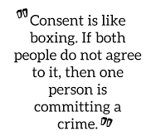
REVIEW: Consent (pg. 8)
Giving consent is active, not passive. This means freely choosing to say 'yes' and also being free to change your mind at any time.
In Western Australia, the legal age for males and females to consent to sexual activity is 16 years of age. If you have sex with someone who is under 16 years of age it is a crime.
Consent can be:
VERBAL – a clearly, spoken agreement.
NON-VERBAL – free and active participation.
Notes:
Relevant to test
Discuss
Instruct students to add any information they did not have in their brainstorm to their work.

Slide 7
REVIEW: Consent – freedom and capacity (pg. 8)
FREEDOM to GIVE consent:
When a person can make the choice to engage in sexual activity freely, free from threats, intimidation or coercion etc.
CAPACITY to GIVE consent:
Even if consent has been given, they still need to have the CAPACITY to do so.
People who DO NOT have the CAPACITY to GIVE consent include:
Anyone under 16 years of age.
Anyone who is unconscious, asleep, intoxicated, drugged, or otherwise unable to say yes.
Anyone who has a psychological or decision-making disability that impacts on their ability to understand what they are consenting to.
If these criteria are not met, and a person is not able to give consent, regardless of age, it is a crime to engage in a sexual relationship or sexual behaviours with that person.
Notes:
Relevant to test (discussed in T1 L7 P.P.)
Discuss
FREEDOM example – if a person has been threatened, black mailed, tricked, coerced, forced, intimidated into having sex → consent cannot be given because the person has not had the freedom to make their own decision, they have been influenced by the other person’s behaviours.

Slide 8
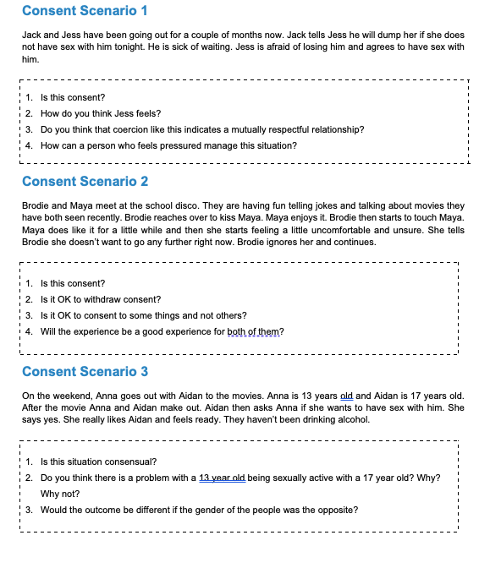
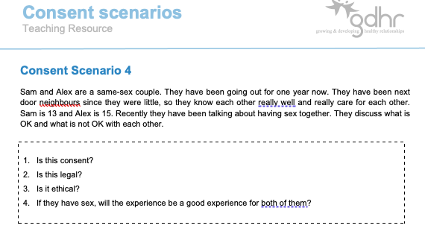
Activity 2: Consent Scenario’s – IS this Consent?
Working in small groups (max. 4 people).
Each group will be given a scenario.
As a group, answer the 4 questions on the card.
Be prepared to share your responses.
You have 5 minutes.
Notes:
OPTIONAL – can also use this as a revision activity.
Resources required – consent scenario cards + teacher information sheet (located in health storeroom).
Students work in groups of 4 max.
Give each group a different scenario.
Allow 5 minutes for students to read and discuss.
At the end of the 5 minutes, get each group to read out their scenario and their responses to the questions (if multiple groups have the same scenario, just get one group to share their answers.

Slide 9

Question Box
If you have a question that you want to ask but you don’t want to ask it out loud… write it on a piece of paper and place it in the question box.
In some lessons we will read out questions that are in the box and your teacher will answer them.
You do not need to write your name – you can remain anonymous if you like!
If you would like to have a chat with your teacher, write your name on your question paper and they can speak with you personally, or just ask to have a chat!

Slide 10
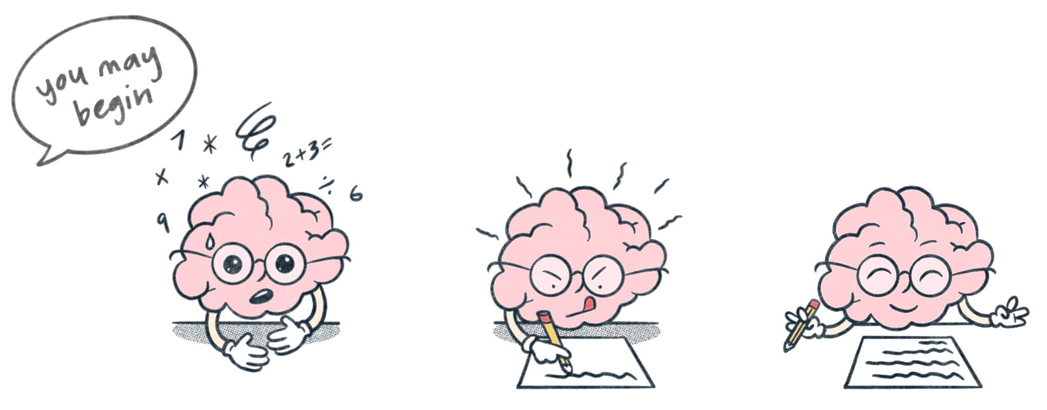
Contraception & STI’s BRAIN DUMP + KWL: (pg. 9)
This term our focus is on contraception and Sexually Transmitted Infections (STI’s).
Dump everything you think you know about CONTRACEPTION and STI’s into the brain dump space on your page.
Complete the first two columns of the KWL:
What do you already KNOW about contraception and STI’s?
What do you WANT to know about contraception and STI’s?
We will revisit what you have LEARNED at the end of the term. Leave this column blank for now.
4 minutes to complete

Slide 11
POST IT SLAM – what is contraception?
Everyone will receive a sticky note.
Answer the question
Once you have answered, place your sticky note on the whiteboard.
You have 30 seconds.
WHAT IS CONTRACEPTION?
Notes:
OPTIONAL
Read answers from the whiteboard. Comment on any common answers.
Resources = sticky notes.
Sticky

Slide 12
What is Contraception? (pg. 10)
Contraception means using an intervention when having sexual intercourse to avoid getting pregnant.
This is different from practising safe sex, which also includes protecting yourself and others from sexually transmitted infections (STIs).
Another common term for contraception is ‘birth control’.
There are a variety of contraceptive methods available depending on a person’s lifestyle and needs.
QUICK QUESTION:
Whose responsibility is it to think about contraception? Why?
BOTH!
Notes:
Relevant to test
Fill in their books.

Slide 13

SPIT FIRE ROUND: What are examples of contraception?
What contraceptive methods do you know?
Call them out!
Notes:
OPTIONAL

Slide 14

ACTIVITY 3: Contraception Types (pg. 10)
While watching the video, write a list of contraception methods that are mentioned into your books.
Notes:
OPTIONAL
Approx. 7 mins
Any extra time can be used to continue with the next PP and the contraception methods.
Video talks about different methods of contraception and how they work, including how hormonal methods impact hormones and prevent pregnancy.
https://youtu.be/kMY-v0F6bX0?si=E83uNy_WVzsVF1I9

Slide 15
Activity 4: (pg. 11) Why do people choose to use/not use contraception?
There are a wide range of contraceptive methods available to use.
Consider reasons why someone would choose to use contraception vs. not use contraception.
Complete the T-chart in your books.
You have 5 minutes. Be prepared to share your responses.
Reasons TO USE contraception: | Reasons NOT TO USE contraception:
Notes:
OPTIONAL ACTIVITY

Slide 16

Activity 4: Answers
Add anything you don’t have to your books.
Reasons TO USE contraception: | Reasons NOT TO USE contraception:
Don’t want children
Some protect from STI’s
Can regulate periods
Clear up acne
Make periods lighter
Reduce migraines
Reduce PMS
Cost
Want children
Allergy
Religion
Convenience
Intoxicated
Lack of knowledge
Notes:
OPTIONAL ACTIVITY

Slide 17

GLOSSARY: (pg. 7)
Contraception:
An intervention method used to prevent pregnancy from occurring.
At the front of your books is your glossary.
Turn to your glossary and add the following words and their definitions:

Slide 18
REFLECTION: How to say no… (pg. 11)
There may be a time in your life where you are in a situation where you may not feel comfortable and want to say no.
This could be any kind of situation, not just in a sexual scenario.
It is important that you can say no when you need to.
Q: What could you do or say when you want to say NO?
Being ASSERTIVE means…
State your answer/response → “No, I don’t want to have sex.”
Use ’I’ statements as this avoids placing the blame on someone else while still expressing how you feel → “I don’t feel comfortable”, “I don’t feel like this is the right time”, “I don’t want to.”
Be understanding.
A: BE ASSERTIVE
Notes:
Write the answer into their books.

